Slide 1

More topics for Lab 2
University of mount union

Slide 2
The draw() function
Code that responds to keyboard or mouse input must run continuously
That’s what code in the draw() block does: runs from top to bottom, then repeats until you hit “stop” or close the window
Each trip through draw() is called a frame
The framerate is 60 frames per second by default, but this can be changed.

Slide 3
The setup() function
This function runs just ONCE when the program starts
Typically, you can use this to define starting values
size() comes first, followed by fill(), stroke(), etc.

Slide 4
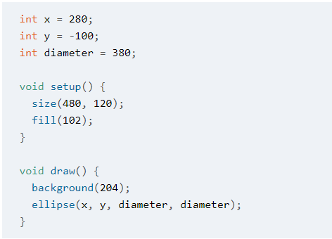
Global Variables
A variable created inside setup() can’t be accessed inside draw(), and vice versa
We can declare variables first so they can be used anywhere in the program
These are called global variables

Slide 5
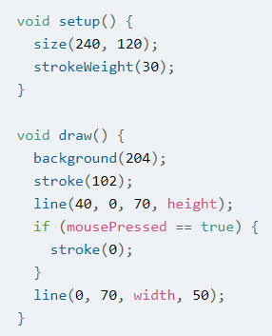
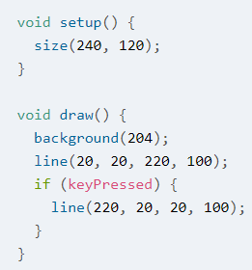
Data types: Booleans
Booleans: true or false
Examples:
mousePressed
keyPressed
Can be used like this:
Or like this:
Here, we have
if mousePressed == true
and Processing interprets that to mean “if mousePressed is true” meaning “if the mouse button has been pressed”
Here, we just have
if (keyPressed)
and Processing interprets that to mean “if keyPressed is true,” meaning “if a key has been pressed”
Either method can be used for mousePressed, keyPressed, or any Boolean variable!

Slide 6
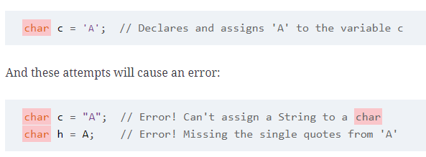
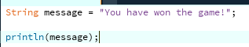
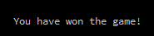
Data types: characters and strings
char (short for character) stores any single character (letter, number, symbol)
Specified by single quotes
Example:
String stores text data (can be many characters)
Specified by double quotes
Example:

Slide 7
Some shortcuts: +=, -=, *=, /=, ++, --
x=x+2; → x+=2;
x=x-2; → x-=2;
x=x*2; → x*=2;
x=x/2; → x/=2;
x=x+1; → x++;
x=x-1; → x--;

Slide 8
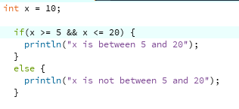
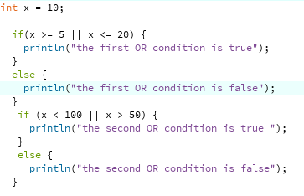
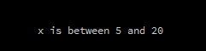
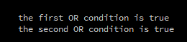
Comparisons
Logical OR (||) operator: at least one side must be true for this condition to be true
Unlike in English where “or” is used to mean just one (“exclusive or”), the || logical operator is still true if both sides are true!
Logical AND (&&) operator: both sides must be true for this condition to be true.

